Slide 1
Relational Database
Management System
116U01C403
Module 2 .1 & 2.2
Jan 2024-May 2024

Slide 2
Data Modeling: Enhanced-Entity-Relationship Model and Relational Data Model
Introduction, Benefits of Data Modeling, Types of Models, Phases of Database Modeling, The Entity-Relationship (ER) Model
Enhanced -Entity-Relationship (EER)- Model Generalization, Specialization and Aggregation
Relational Model: Introduction, Data Manipulation, Data Integrity, Advantages of the Relational Model
Mapping EER Model to Relational Model

Slide 3
Overview of Database Design Process
Two main activities:
Database design:
To design the conceptual schema for a database application
Applications design:
To focus on the programs and interfaces that access the database

Slide 4
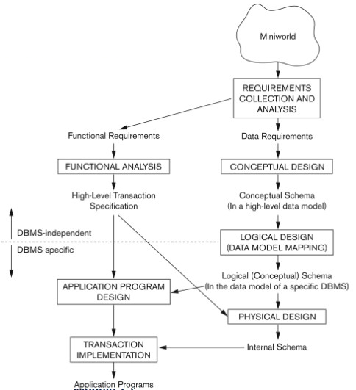
Database design process

Slide 5
ER Model (Entity Relational Model)
The Entity Relational Model is a model for identifying entities to be represented in the database and representation of how those entities are related.
The ER data model specifies enterprise schema that represents the overall logical structure of a database graphically.
Why Use ER Diagrams In DBMS?
ER diagrams are used to represent the E-R model in a database, which makes them easy to be converted into relations (tables).
ER diagrams provide the purpose of real-world modeling of objects which makes them intently useful.
ER diagrams require no technical knowledge and no hardware support.
These diagrams are very easy to understand and easy to create even for a naive user.
It gives a standard solution for visualizing the data logically.

Slide 6
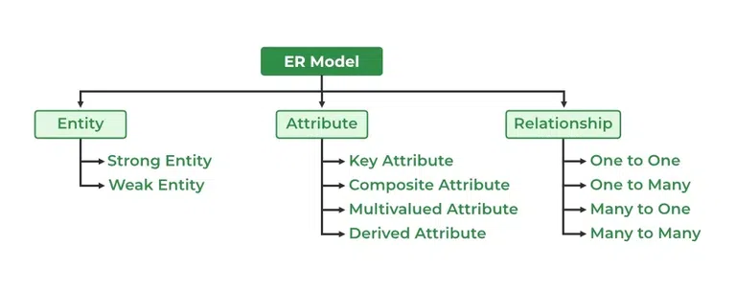
Components of ER Model

Slide 7
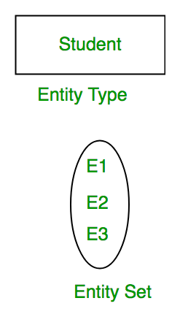
Entity
An Entity may be an object with a physical existence – a particular person, car, house, or employee – or it may be an object with a conceptual existence – a company, a job, or a university course.
Entity Set: An Entity is an object of Entity Type and a set of all entities is called an entity set. For Example, E1 is an entity having Entity Type Student and the set of all students is called Entity Set.

Slide 8
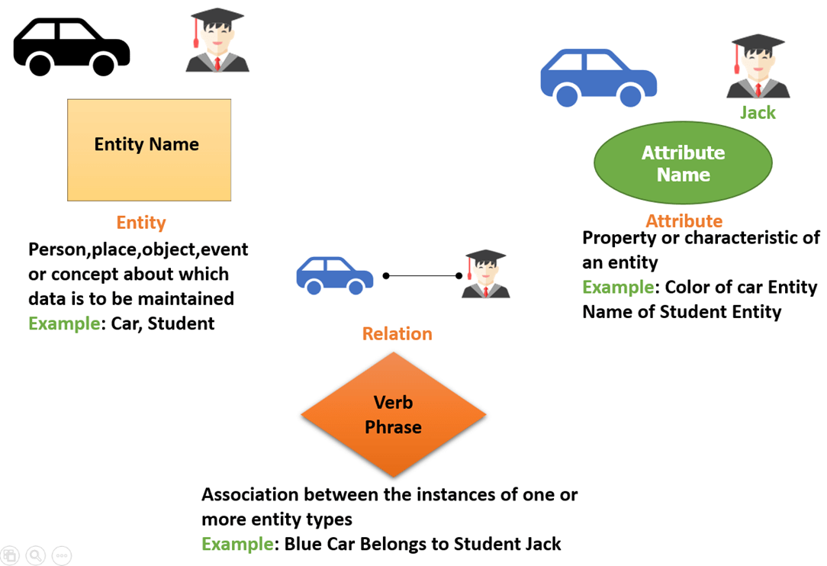

Slide 9
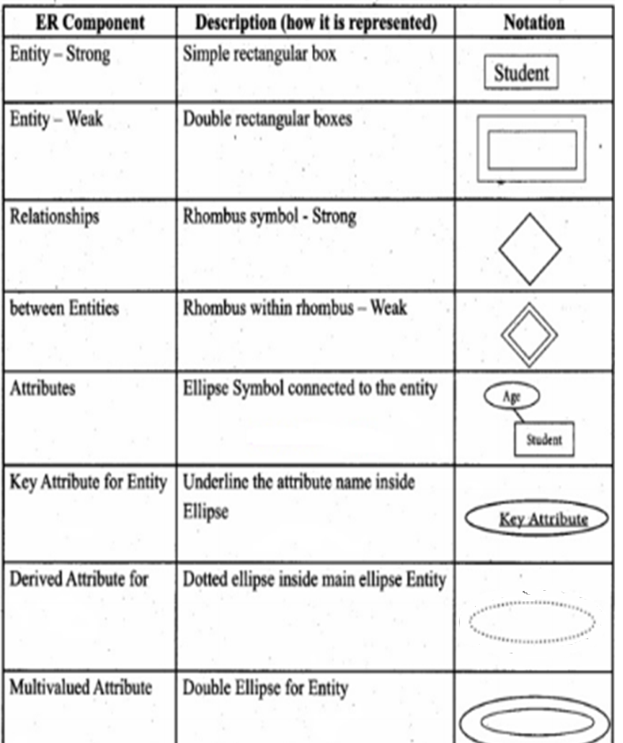
Symbols Used in ER Model

Slide 10
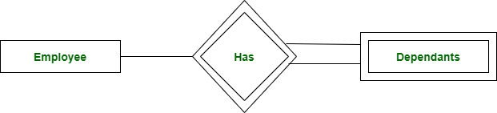
1. Strong Entity
A Strong Entity is a type of entity that has a key Attribute. Strong Entity does not depend on other Entity in the Schema. It has a primary key, that helps in identifying it uniquely, and it is represented by a rectangle. These are called Strong Entity Types.
2. Weak Entity
An Entity type has a key attribute that uniquely identifies each entity in the entity set. But some entity type exists for which key attributes can’t be defined. These are called Weak Entity types.
For Example, A company may store the information of dependents (Parents, Children, Spouse) of an Employee. But the dependents don’t have existed without the employee. So Dependent will be a Weak Entity Type and Employee will be Identifying Entity type for Dependent, which means it is Strong Entity Type.

Slide 11
Attributes
Attributes are the properties that define the entity type. For example, Roll_No, Name, DOB, Age, Address, and Mobile_No are the attributes that define entity type Student.
Key Attribute
The attribute which uniquely identifies each entity in the entity set is called the key attribute. For example, Roll_No will be unique for each student.
Composite Attribute
An attribute composed of many other attributes is called a composite attribute. For example, the Address attribute of the student Entity type consists of Street, City, State, and Country. In ER diagram, the composite attribute is represented by an oval comprising of ovals.
Multivalued Attribute
An attribute consisting of more than one value for a given entity. For example, Phone_No (can be more than one for a given student).
Derived Attribute
An attribute that can be derived from other attributes of the entity type is known as a derived attribute. e.g.; Age (can be derived from DOB).

Slide 12
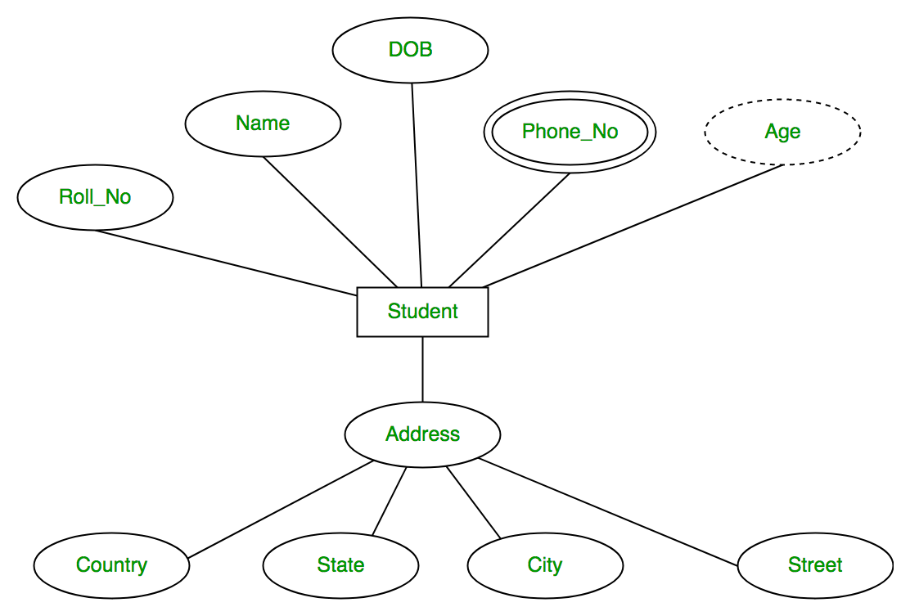

Slide 13
Example COMPANY Database
We need to create a database schema design based on the following (simplified) requirements of the COMPANY Database:
  The company is organized into DEPARTMENTs. Each department has a name, number and an employee who manages the department.
  We keep track of the start date of the department manager. A department may have several locations.
  Each department controls a number of PROJECTs. Each project has a unique name, unique number and is located at a single location.

Slide 14
We store each EMPLOYEE’s social security number, address, salary, gender, and birthdate.
  Each employee works for one department but may work on several projects.
  We keep track of the number of hours per week that an employee currently works on each project.
We also keep track of the direct supervisor of each employee.
  Each employee may have a number of DEPENDENTs.
  For each dependent, we keep track of their name, gender, birthdate, and relationship to the employee.

Slide 15
ER Model Concepts
Entities and Attributes
  Entities(noun) are specific objects or things in the mini-world that are represented in the database.
    For example the EMPLOYEE John Smith, the Research DEPARTMENT, the ProductX PROJECT
  Attributes are properties used to describe an entity.
    For example an EMPLOYEE entity may have the attributes Name, SSN,Address, gender, BirthDate
  A specific entity will have a value for each of its attributes.
    For example a specific employee entity may have Name='John Smith’, SSN='123456789', Address ='731, Fondren, Houston, TX’, gender='M’, BirthDate='09-JAN-55‘
  Each attribute has a value set (or data type) associated with it – e.g. integer, string, subrange, enumerated type, …

Slide 16
Initial Design of Entity Types for the
COMPANY Database Schema
Based on the requirements, we can identify four initial entity types in the COMPANY database:
  DEPARTMENT
  PROJECT
  EMPLOYEE
  DEPENDENT
The initial attributes shown are derived from the requirements description

Slide 17
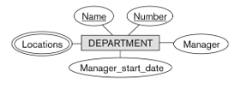

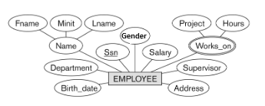

Initial Design of Entity Types:

Slide 18
Relationships and Relationship Types
A relationship relates two or more distinct entities with a specific meaning.
  For example, EMPLOYEE John Smith works on the ProductX PROJECT, or EMPLOYEE Franklin Wong manages the Research DEPARTMENT.
Relationships of the same type are grouped or typed into a relationship type.
  For example, the WORKS_ON relationship type in which EMPLOYEEs and PROJECTs participate, or the MANAGES relationship type in which EMPLOYEEs and DEPARTMENTs participate.
The degree of a relationship type is the number of participating entity types.
  Both MANAGES and WORKS_ON are binary relationships.

Slide 19
Relationship Types
There are different types of Relationships like:
Binary Relationship
Ternary Relationship
N-Ary Relationship
Recursive Relationship

Slide 20
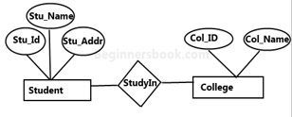
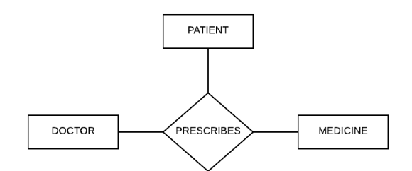
Binary Relationship:
When there is a relationship between
two different entities, it is known as
a binary relationship.
Ternary Relationship:
When there is a relationship between
three different entities, it is known as
a ternary relationship.

Slide 21

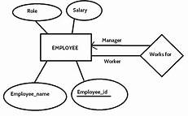
N-Ary Relationship: When any relationship consists of more than two Entities then it is called N-ary relationship.
Recursive Relationship
A relationship between two entities of
similar entity type is called a recursive
relationship.
Here the same entity type participates
more than once in a relationship type
with a different role for each instance.
We indicate roles in E-R diagrams by labeling the
lines that connect diamonds to rectangles.

Slide 22
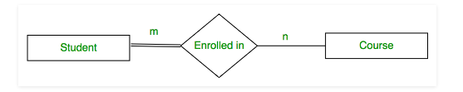
Participation Constraint
Participation Constraint is applied on the entity participating in the relationship set.
Total Participation:
Each entity in the entity set must participate in the relationship.
If each student must enroll in a course, the participation of student will be total.
Total participation is shown by double line in ER diagram.

Slide 23
Partial Participation
The entity in the entity set may or may NOT participate in the relationship.
If some courses are not enrolled by any of the student, the participation of course will be partial.
The diagram depicts the ‘Enrolled in’ relationship set with Student Entity set having total participation and Course Entity set having partial participation.

Slide 24
Mapping Cardinality/Mapping Constraints
Mapping cardinalities, or cardinality ratios, express the number of entities to which another entity can be associated via a relationship set.
For a binary relationship set R between entity sets A and B, the mapping cardinality must be one of the following:
One-To-One
One-To-Many
Many-To-One
Many-To-Many

Slide 25
One-To-One
An entity in A is associated with at most one entity in B, and an entity in B is associated with at most one entity in A.
E.g. In a university database, a student can have one ID card, and each ID card is assigned to one student.
We draw a directed line from the relationship set advisor to both entity sets instructor and student.
This indicates that an instructor may advise Each student has exactly one ID card, and each ID card belongs to exactly one student.
.
Has
Student
Student_IDCard

Slide 26
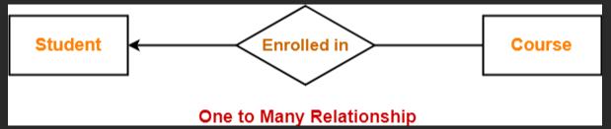
Mapping Cardinality
One-To-Many:An entity in A is associated with any number (zero or more)of entities in B. An entity in B, however, can be associated with at most one entity in A.
E.g. An instructor may advise many students, but a student may have at most one advisor.
e.g. A student can enrol for many courses

Slide 27
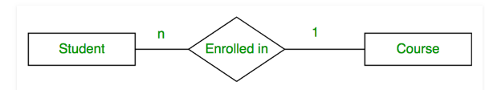
Many-To-One
An entity in A is associated with at most one entity in B. An entity in B, however, can be associated with any number (zero or more) of entities in A.
This is another notation which shows student can take at most one course and one course can be taken by many students.

Slide 28
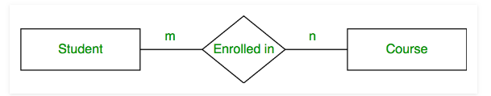
Many-To-Many
An entity in A is associated with any number (zero or more)of entities in B, and an entity in B is associated with any number (zero or more) of entities in A.
An instructor may advise many students, and a student may have many advisors.
This is another notation to show mapping cardinality. Which shows one student can take many courses and one course can be taken by many students.

Slide 29
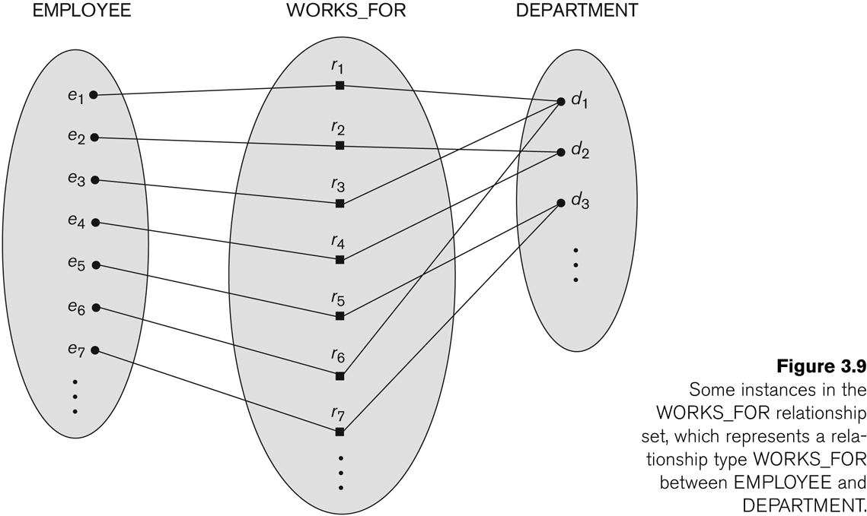
Relationship instances of the WORKS_FOR N:1 relationship between EMPLOYEE and DEPARTMENT

Slide 30
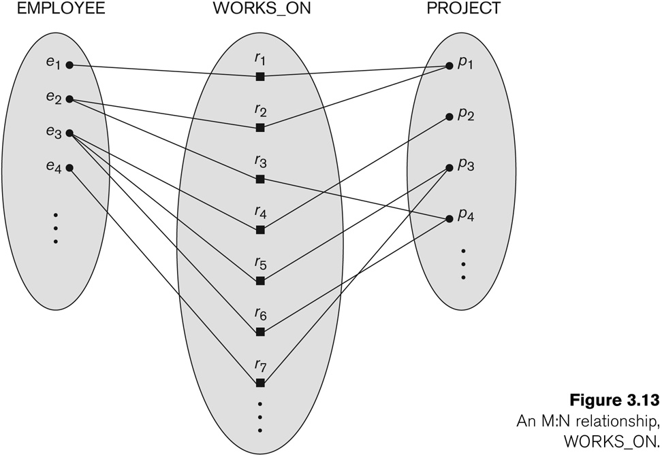
Relationship instances of the M:N WORKS_ON relationship between EMPLOYEE and PROJECT

Slide 31
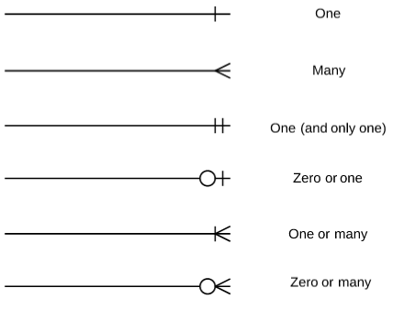
Crow foot notation for an ER diagram

Slide 32
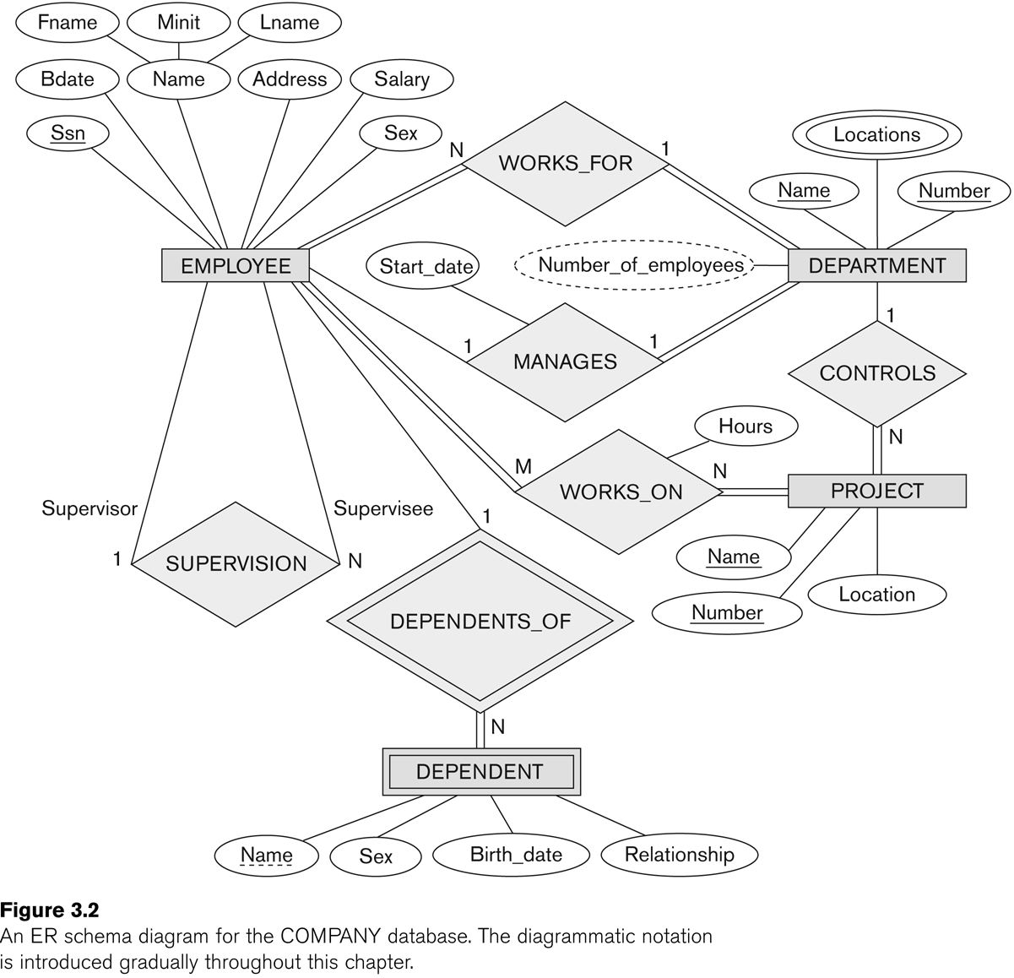

Slide 33
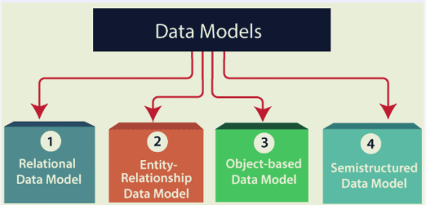
Types of Relational Models
Hierarchical Model
Network Model
Flat Data Model
Associative Data Model
Context Data Model

Slide 34
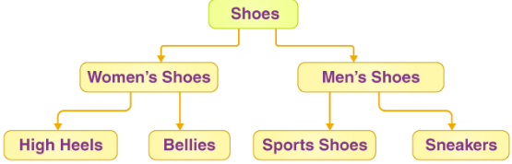
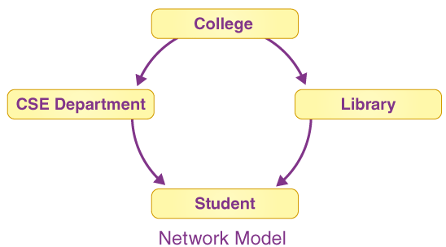
Hierarchical Model
In this, the data is organized into a tree-like structure where each record consists of one parent record and many children.
Network Model
Any record can have several parents in the network model. It uses a graph instead of a hierarchical tree.

Slide 35
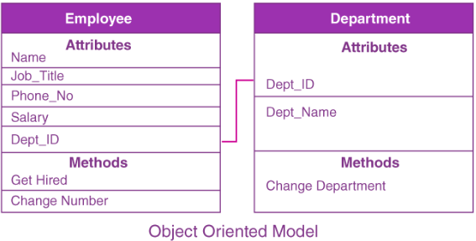
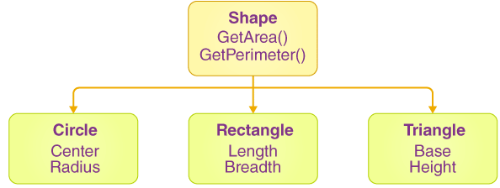
Object-Oriented Data Model
Both data and the data relationships are stored into a single structure that’s known as an object in the object-oriented data model.
Object-Relational Data Model
This model was developed to bridge the gap between the Object-Oriented and relational models.
Many additional capabilities are available, such as the ability to create complicated data types based on our requirements utilizing existing data types.
The issue with this paradigm is that it can become overly complicated and difficult to manage.

Slide 36
Flat Data Model
It’s a straightforward model in which the DB is depicted as a table with rows and columns.
A flat data model is one in which all of the data is kept in the same plane.
This data model has one drawback it cannot store a large amount of data that is the tables can not be of large size.
Semi-Structured Data Model
Semi-structured data refers to the structured data that doesn’t adhere to the tabular structure of the data models that are associated with relational DBs.

Slide 37
Associative Data Model
It is a model in which the data is separated into two sections.
Everything that has its own existence is referred to as an entity, and the relationships between these entities are referred to as associations.
Items and links are two types of data that are separated into two components.
Context data model
It is simply a data model which consists of more than one data model.
For example, the Context data model consists of ER Model, Object-Oriented Data Model, etc. This model allows users to do more than one thing which each individual data model can do.

Slide 38
Enhanced Entity Relationship model
It is a diagrammatic technique for displaying the following concepts:
Sub Class and Super Class
Specialization and Generalization
Union or Category
Aggregation

Slide 39
Subclasses and Superclasses
An entity type may have additional meaningful subgroupings of its entities
  Example: EMPLOYEE may be further grouped into:
    SECRETARY, ENGINEER, TECHNICIAN, …
      Based on the EMPLOYEE’s Job
    MANAGER
      EMPLOYEEs who are managers
    SALARIED_EMPLOYEE, HOURLY_EMPLOYEE
      Based on the EMPLOYEE’s method of pay
EER diagrams extend ER diagrams to represent these additional subgroupings, called subclasses or subtypes

Slide 40
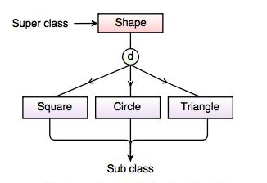
Sub class and Super class relationship leads the concept of Inheritance.
1. Super Class: Super class is an entity type that has a relationship with one or more subtypes.
For example: Shape super class is having sub groups as Square, Circle, Triangle.
2. Sub Class: It is a group of entities with unique
attributes.
Sub class inherits properties and attributes
From its super class.
For example: Square, Circle, Triangle are the sub class
of Shape super class.

Slide 41
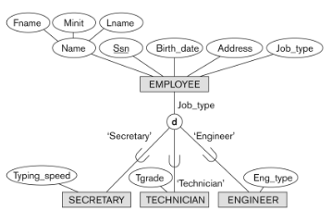
Representing Specialization in EER Diagrams

Slide 42
Attribute Inheritance in Superclass / Subclass Relationships
An entity that is member of a subclass inherits
  All attributes of the entity as a member of the superclass
  All relationships of the entity as a member of the superclass
Example:
  In the previous slide, SECRETARY (as well as TECHNICIAN and ENGINEER) inherit the attributes Name, SSN, …, from EMPLOYEE
  Every SECRETARY entity will have values for the inherited attributes
Slide 4- 42
Notes:
42

Slide 43
Specialization (1)
Specialization is the process of defining a set of subclasses of a superclass
The set of subclasses is based upon some distinguishing characteristics of the entities in the superclass
  Example: {SECRETARY, ENGINEER, TECHNICIAN} is a specialization of EMPLOYEE based upon job type.
    May have several specializations of the same superclass
Slide 4- 43
Notes:
43

Slide 44
Specialization (2)
Example: Another specialization of EMPLOYEE based on method of pay is {SALARIED_EMPLOYEE, HOURLY_EMPLOYEE}.
  Superclass/subclass relationships and specialization can be diagrammatically represented in EER diagrams
  Attributes of a subclass are called specific or local attributes.
    For example, the attribute TypingSpeed of SECRETARY
  The subclass can also participate in specific relationship types.
    For example, a relationship BELONGS_TO of HOURLY_EMPLOYEE
Slide 4- 44
Notes:
44

Slide 45
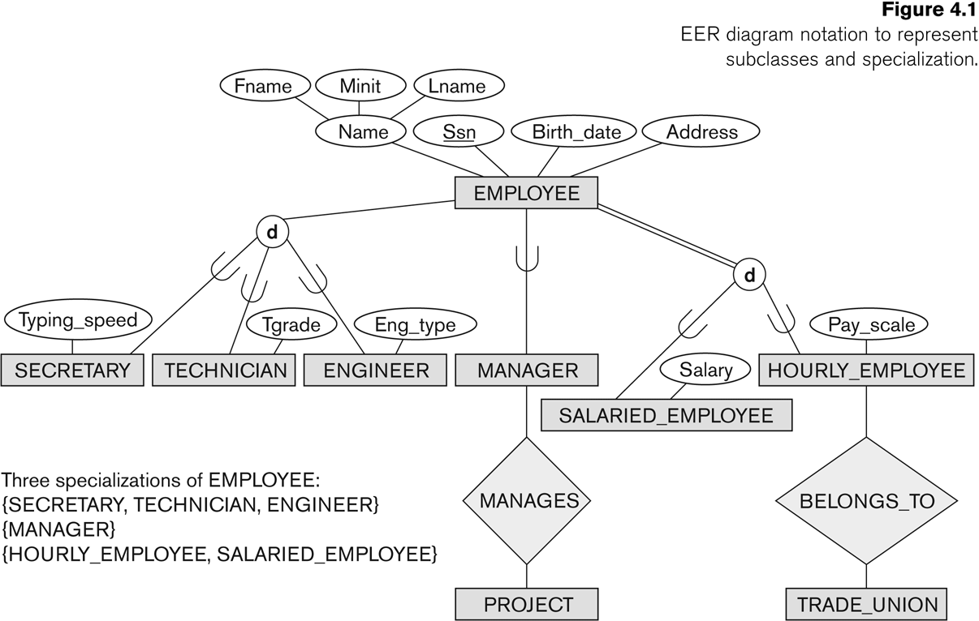
Specialization (3)
Slide 4- 45
Notes:
45

Slide 46
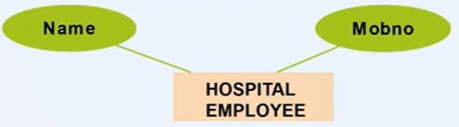
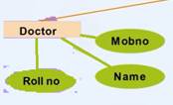
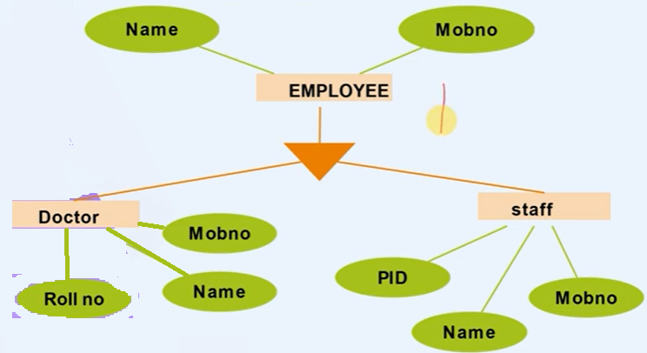
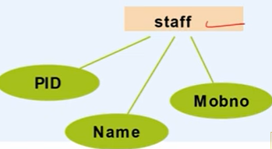
Example of Specialization

Slide 47
Generalization
Generalization is the reverse of the specialization process
Several classes with common features are generalized into a superclass;
  original classes become its subclasses
Example: CAR, TRUCK generalized into VEHICLE;
  both CAR, TRUCK become subclasses of the superclass VEHICLE.
  We can view {CAR, TRUCK} as a specialization of VEHICLE
  Alternatively, we can view VEHICLE as a generalization of CAR and TRUCK
Slide 4- 47
Notes:
47

Slide 48
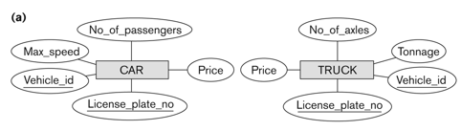
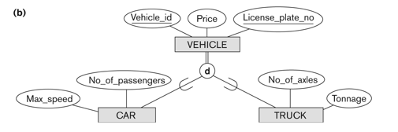

Generalization (2)
Slide 4- 48
Notes:
48

Slide 49
Generalization and Specialization (1)
Diagrammatic notation are sometimes used to distinguish between generalization and specialization
  Arrow pointing to the generalized superclass represents a generalization
  Arrows pointing to the specialized subclasses represent a specialization
  We do not use this notation because it is often subjective as to which process is more appropriate for a particular situation
  We advocate not drawing any arrows
Slide 4- 49
Notes:
49

Slide 50
Generalization and Specialization (2)
Data Modeling with Specialization and Generalization
  A superclass or subclass represents a collection (or set or grouping) of entities
  It also represents a particular type of entity
  Shown in rectangles in EER diagrams (as are entity types)
  We can call all entity types (and their corresponding collections) classes, whether they are entity types, superclasses, or subclasses
Slide 4- 50
Notes:
50

Slide 51
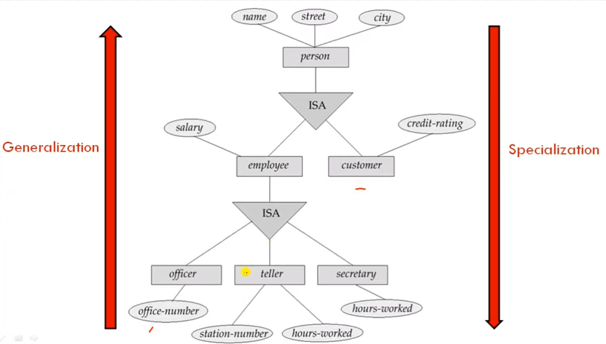

Slide 52
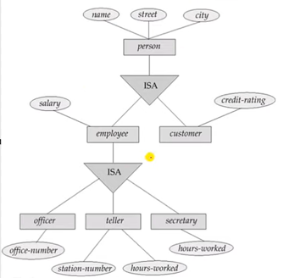
Four tables can be formed:
Customer(name,street,city,credit_rating)
Officer(name,street,city,salary,office_number)
Teller(name,street,city,salary,station_number,hours_worked)
Secretary(name,strret,city,hours_worked)

